Slide 1
ECE 5397/6397:
Introduction to Robotics
Lecture 5:
Forward kinematics: Denavit-Hartenberg convention and the derivation of D-H transformation matrix, assigning link frames using the DH convention.
Reference: Chapter 3.1 and 3.2, RD&C
Instructor: Aaron T. Becker

Slide 2
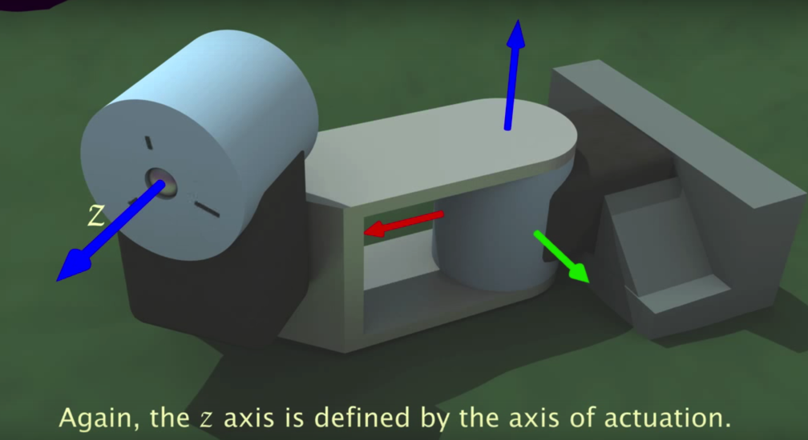
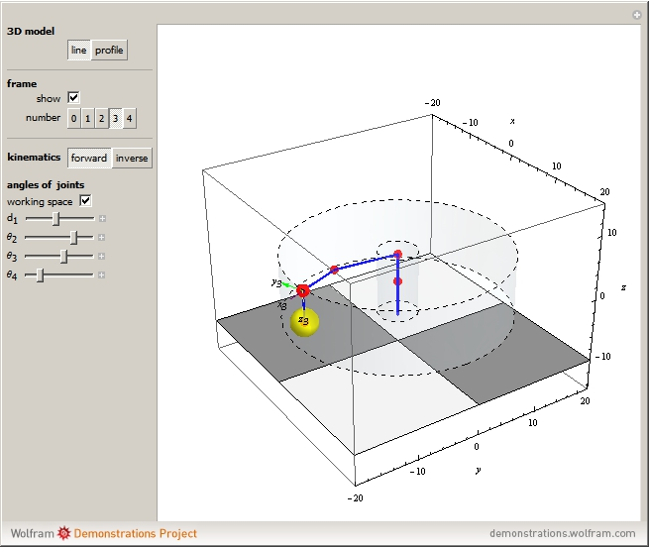
Resources
https://www.youtube.com/watch?v=rA9tm0gTln8
http://demonstrations.wolfram.com/ForwardAndInverseKinematicsOfTheSCARARobot/
Notes:
How many robots?

Slide 3
Update!
We’re ordering robot parts today. How many want to make a robot arm (at least 1 arm per team)
We’re scaling back the Swarmathon & ROS component of the class.
Still have assignment on the turtle simulator
Still need to have one person in the team who can run the simulation code (or have time to use UH computer with ROS)
The course gets easier after inverse kinematics
HW 2 on Fwd. Kinematics due Feb 11
Notes:
How many robots?

Slide 4
Overview
https://www.youtube.com/watch?v=rA9tm0gTln8
How can we assign coordinate frames to this manipulator?
Notes:
Draw in the parameters on this

Slide 5
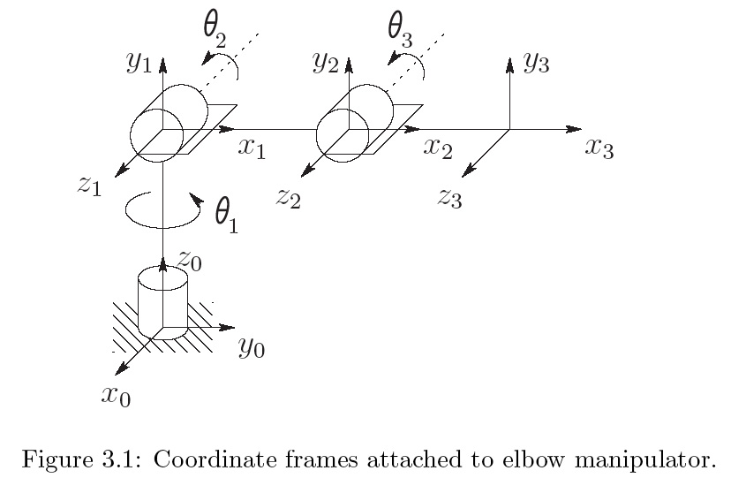
03_01
Elbow Manipulator
Notes:
03_01.jpg

Slide 6
Define
Forward kinematics: determine position and orientation of the end effector given values of joint variables of robot
Inverse kinematics: determine the values for joint variables given the end-effector’s position and orientation
Rule: each joint a single DOF
Ball and socket, 2DOF
Spherical Wrist, 3 DOF
Robot has n joints and n+1 links. Start at link 0
Joint i connects links i-1 to i.
When joint i moves, link i moves
Label base frame as 0, attach coordinate frame to each link.
Base frame is the inertial frame

Slide 7
Homogenous Transform for each link
A coordinate frame has 6 DoF
Our convention adds two constraints
Notes:
Write the DH constraints on the board

Slide 8
DH Constraints
DH1: The axis x₁ is perpendicular to the axis z₀
DH2: The axis x₁ is intersects the axis z₀
Notes:
Draw in the parameters on this

Slide 9
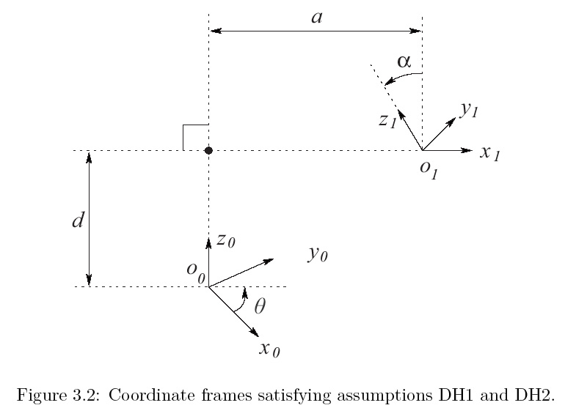
DH Constraints
DH1: The axis x₁ is perpendicular to the axis z₀
DH2: The axis x₁ intersects the axis z₀
Notes:
Draw in the parameters on this

Slide 10
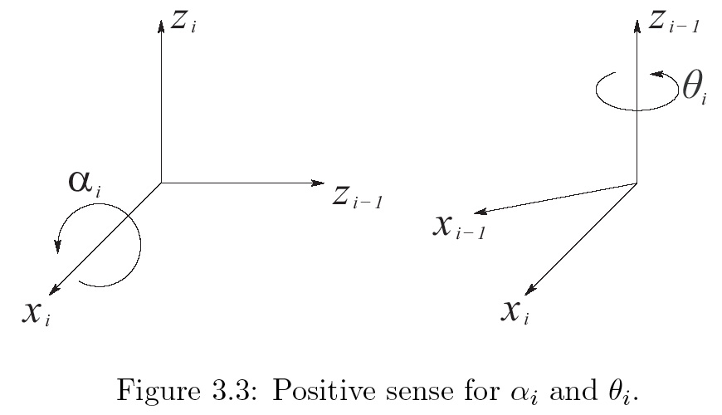
Angle Convention
Right-hand rule

Slide 11
DH procedure

Slide 12
Two link planar manipulator

Slide 13
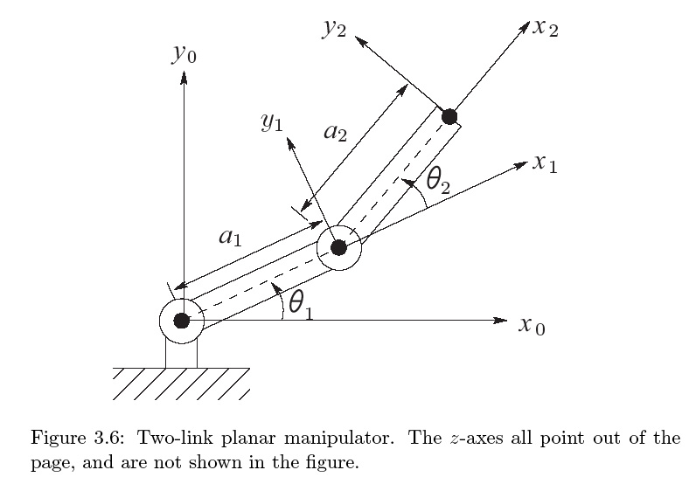
Two link planar manipulator

Slide 14
Two link planar manipulator

Slide 15
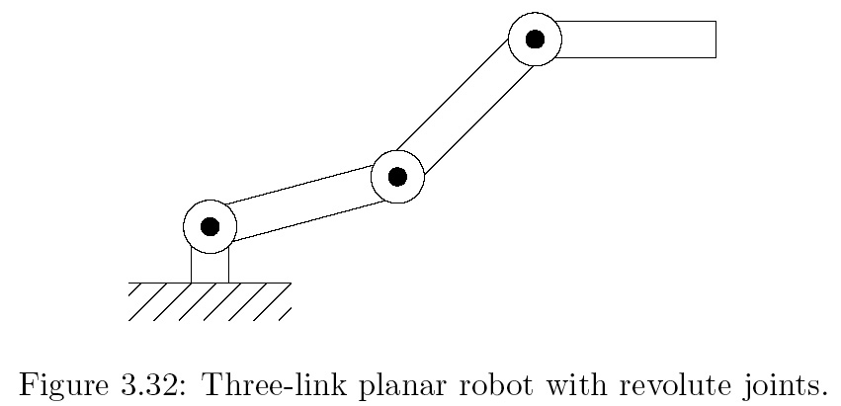
3-link planar arm: draw it
Work in pairs

Slide 16
3-link planar arm, answer

Slide 17
Three-link Cylindrical Robot

Slide 18
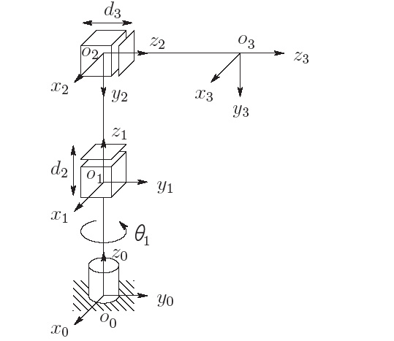
Three-link Cylindrical Robot A_{i}

Slide 19
Three-link Cylindrical Robot, T

Slide 20
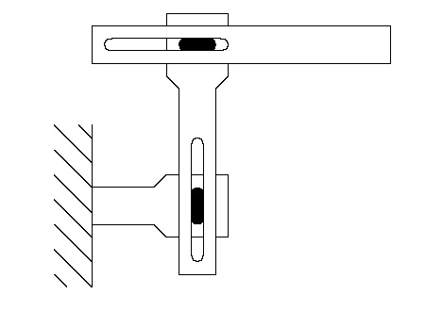
Two-link Cartesian Robot:

Slide 21
Two-link Cartesian Robot:

Slide 22
For the Next Class
Study Ch 3.1 and 3.2
Ch1 & 2 A Gentle Introduction to ROS for Lecture 6

